Slide 1
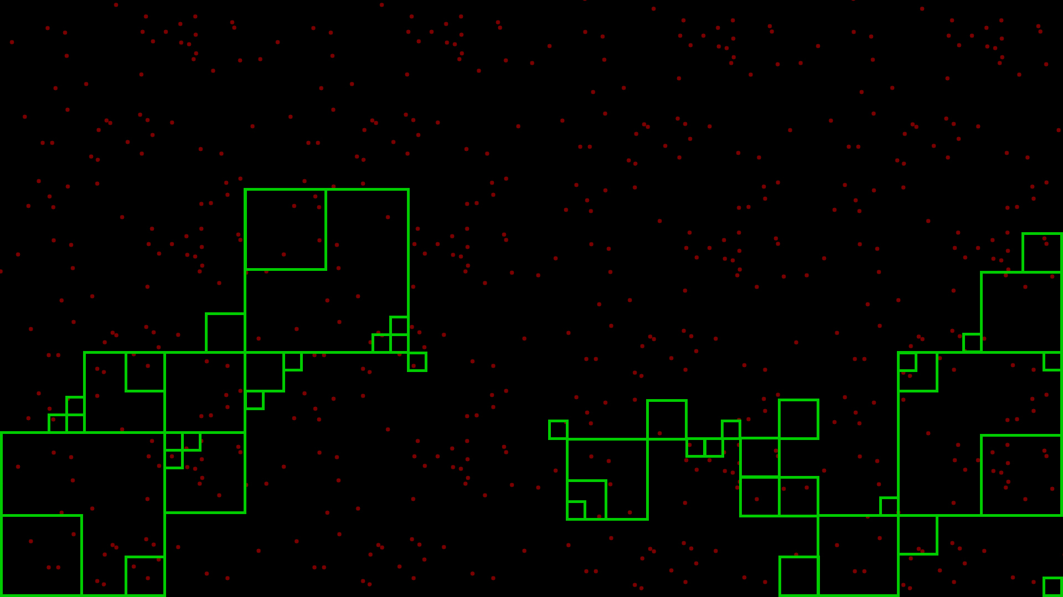
Optimized Search Manager
Xavier Olivenza
Research
CITM 2016-17

Slide 2
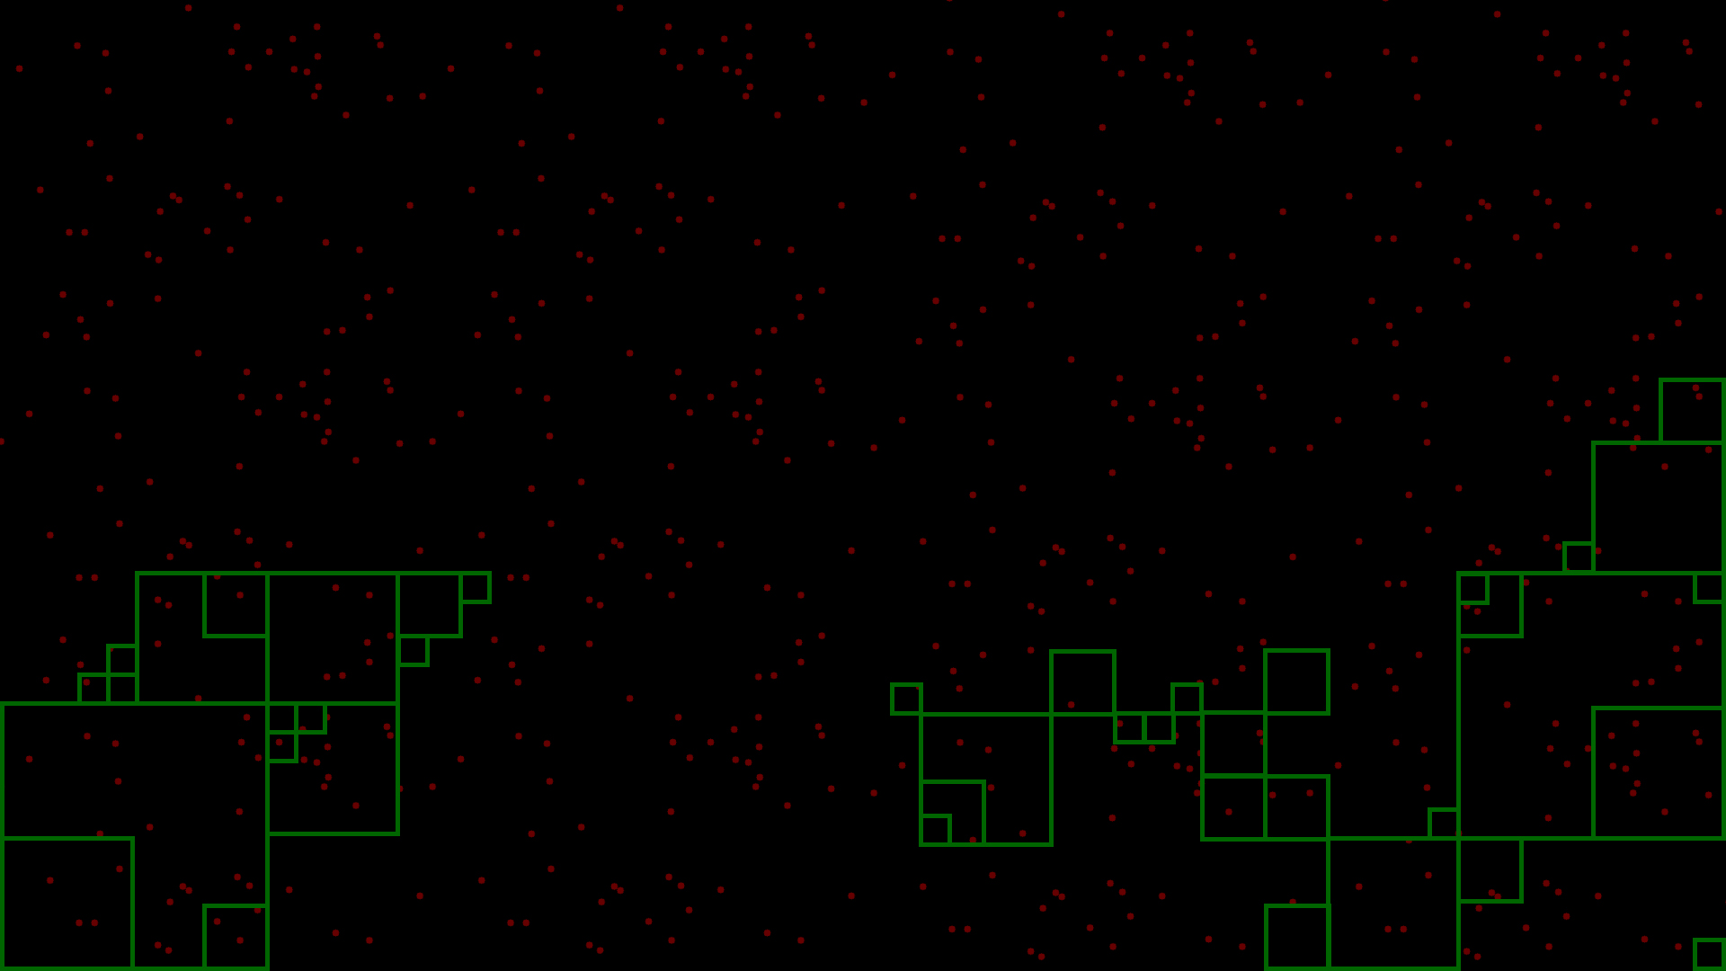
What is a search engine for?
-Search for an entity in an area/range

Slide 3
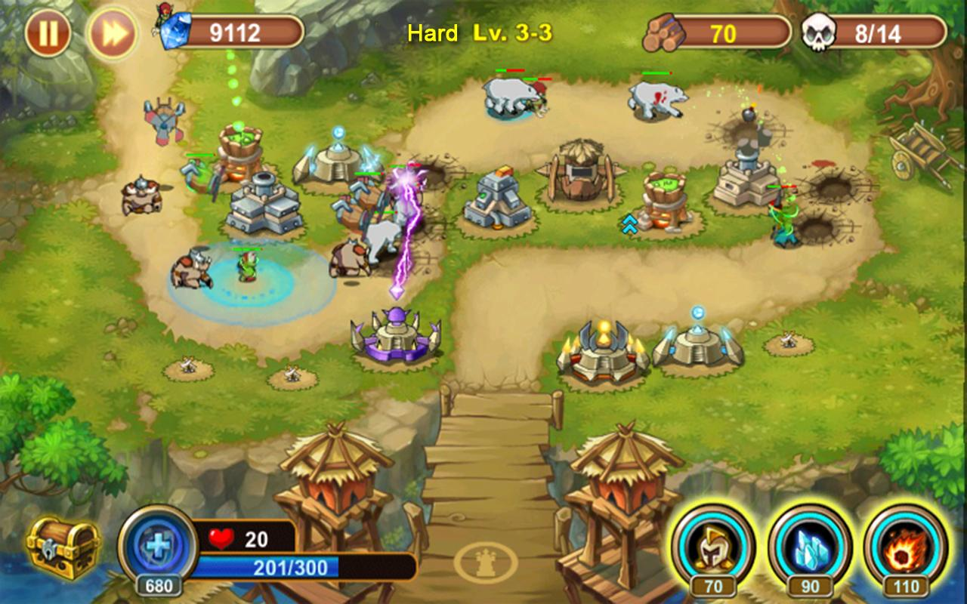
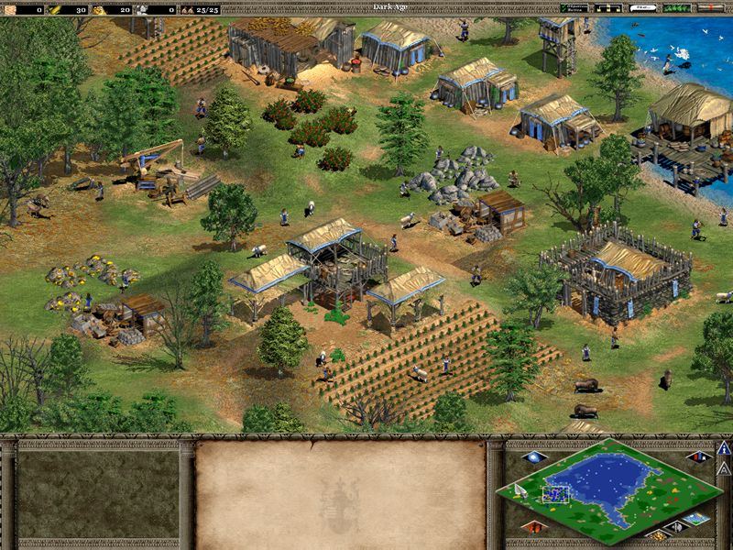

Where I can use this?

Slide 4
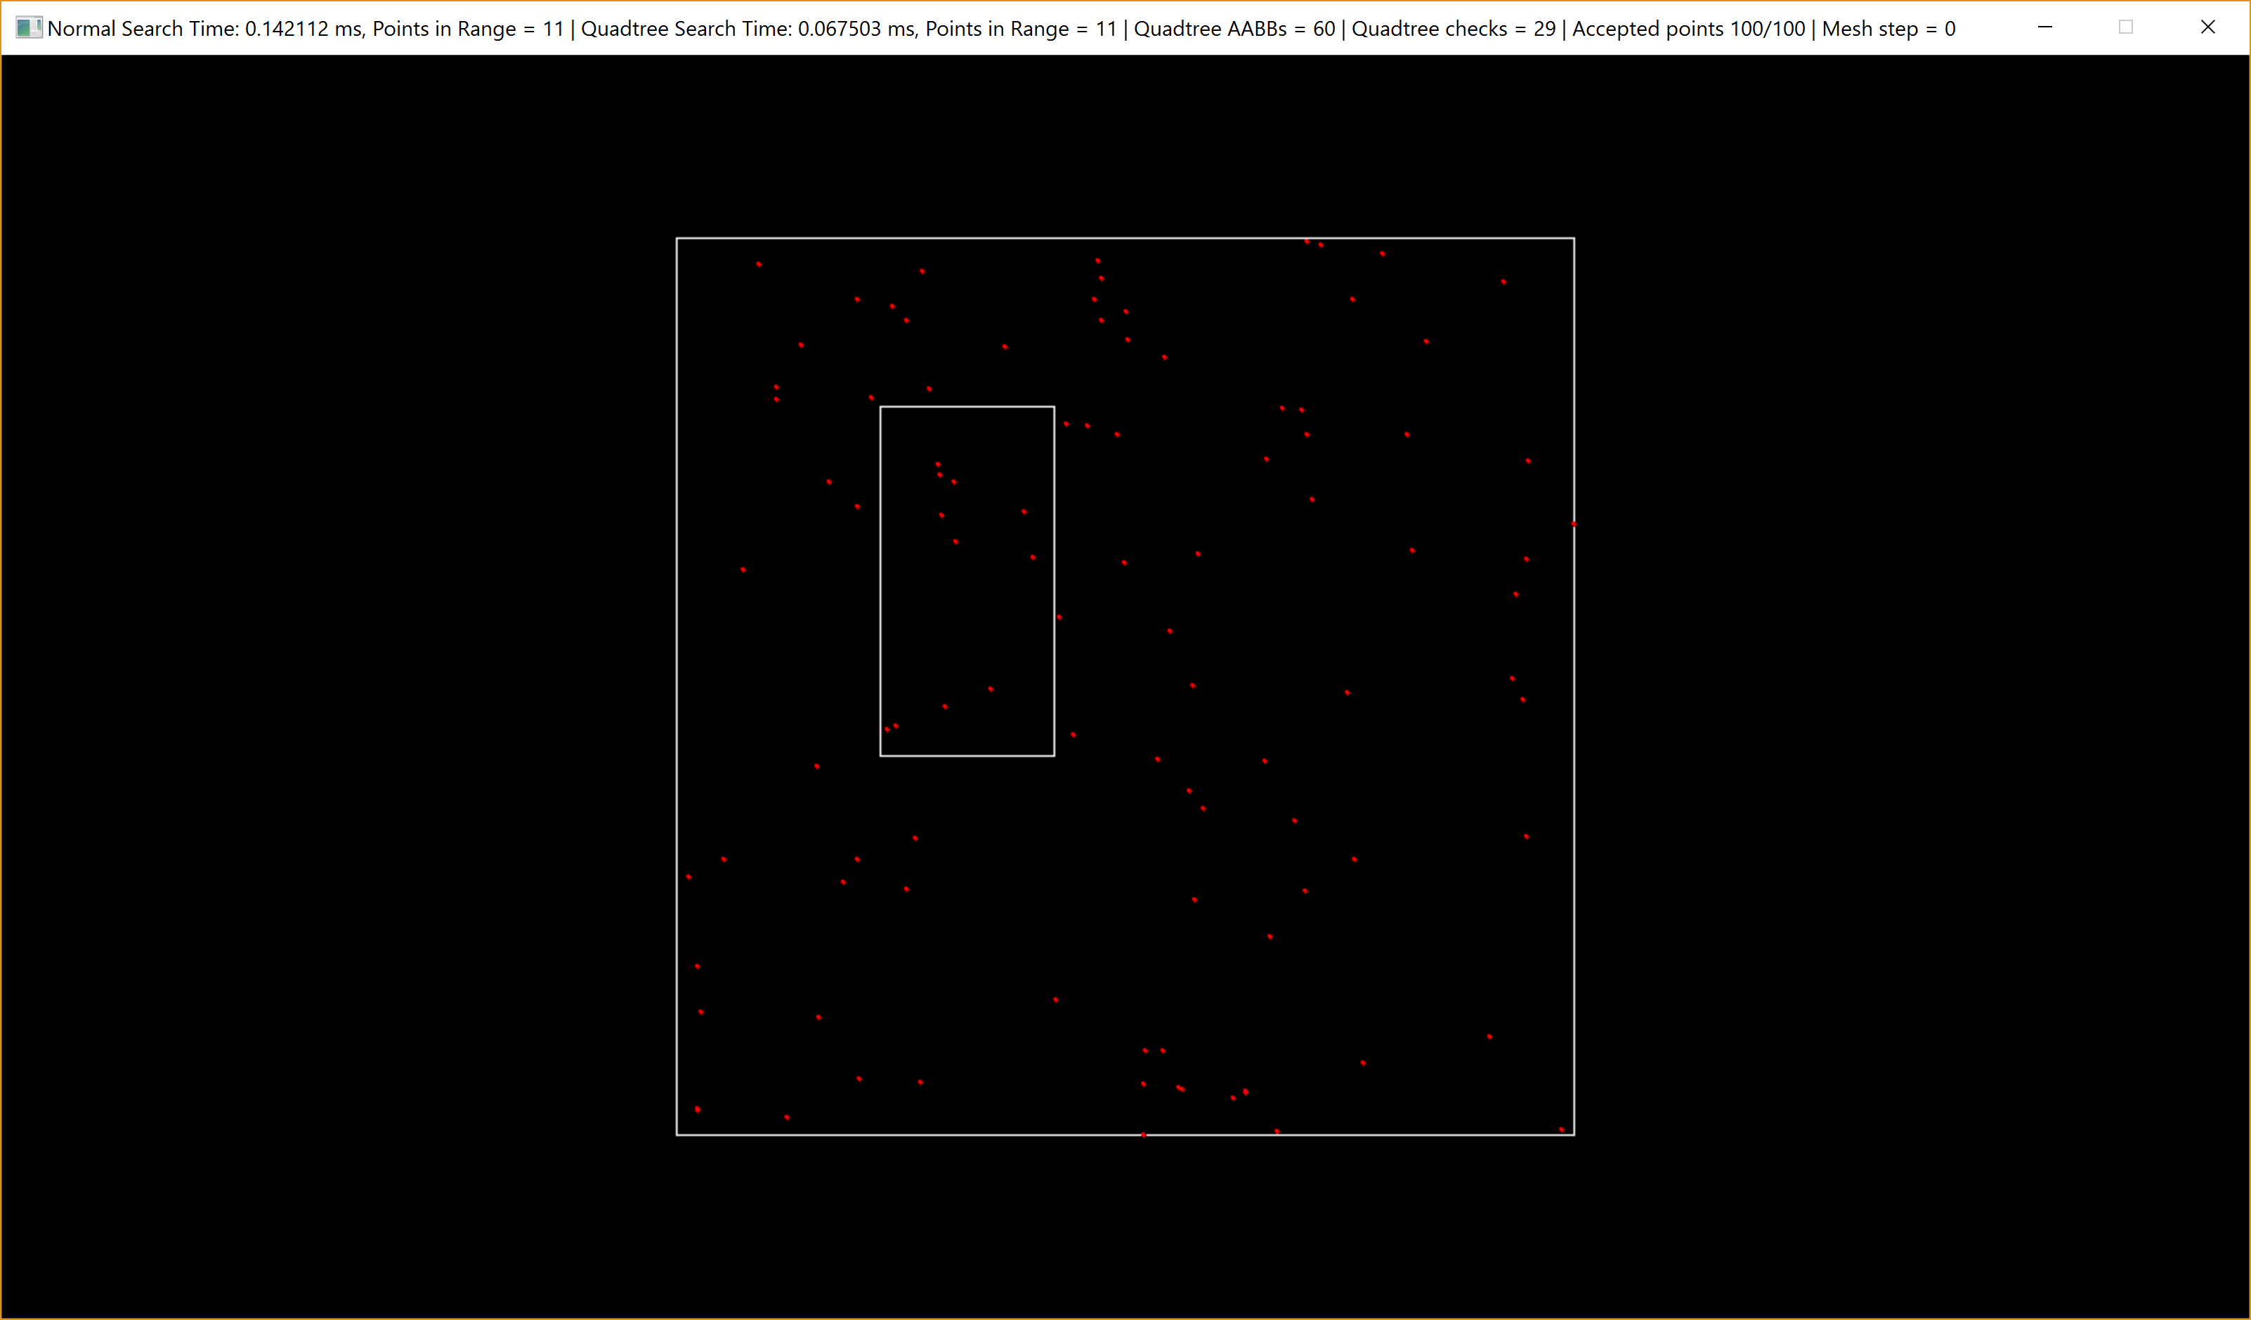
Brute force
-You have to do as many checks as entities are evaluated
…
-What happens if we group and order the entities?

Slide 5
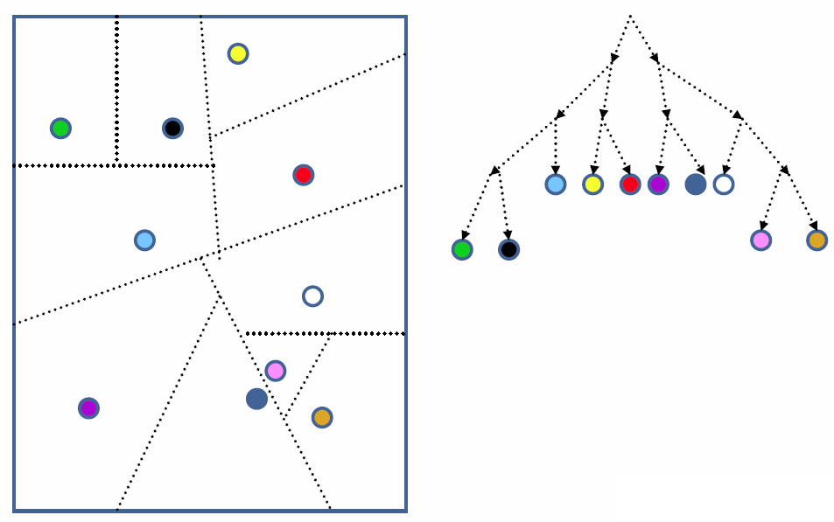
Space Partitioning
·Dividing a space into two or more subsets which do not overlap
·Algorithms that tend to be hierarchical
Most common partition data structures:
· BSP Trees
· Quadtrees
· Octrees
· K-dimensional trees
· R-Trees

Slide 6
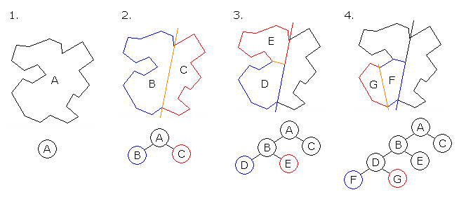
Binary Space Partitioning (BSP)
·Generalization
·Origin: Quickly draw polygonal 3d scenes
·Slow generation -> Pre-calculate

Slide 7

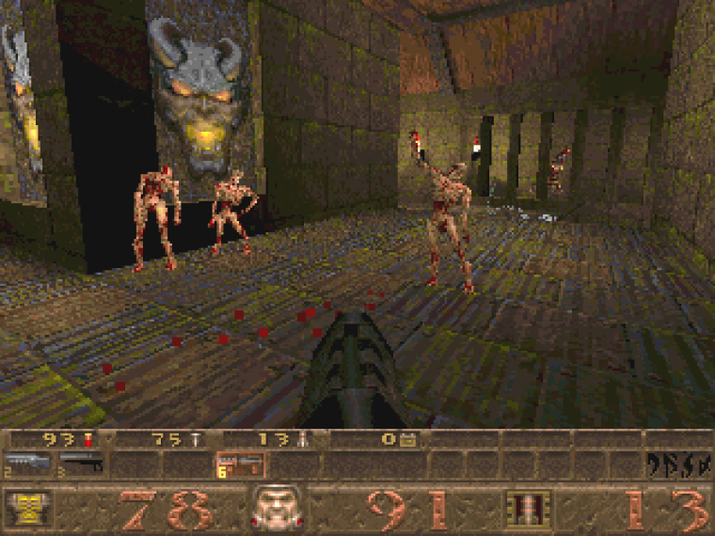
BSP, Where is used?
Id-Teck 1 Doom
Quake Engine + descendants

Slide 8
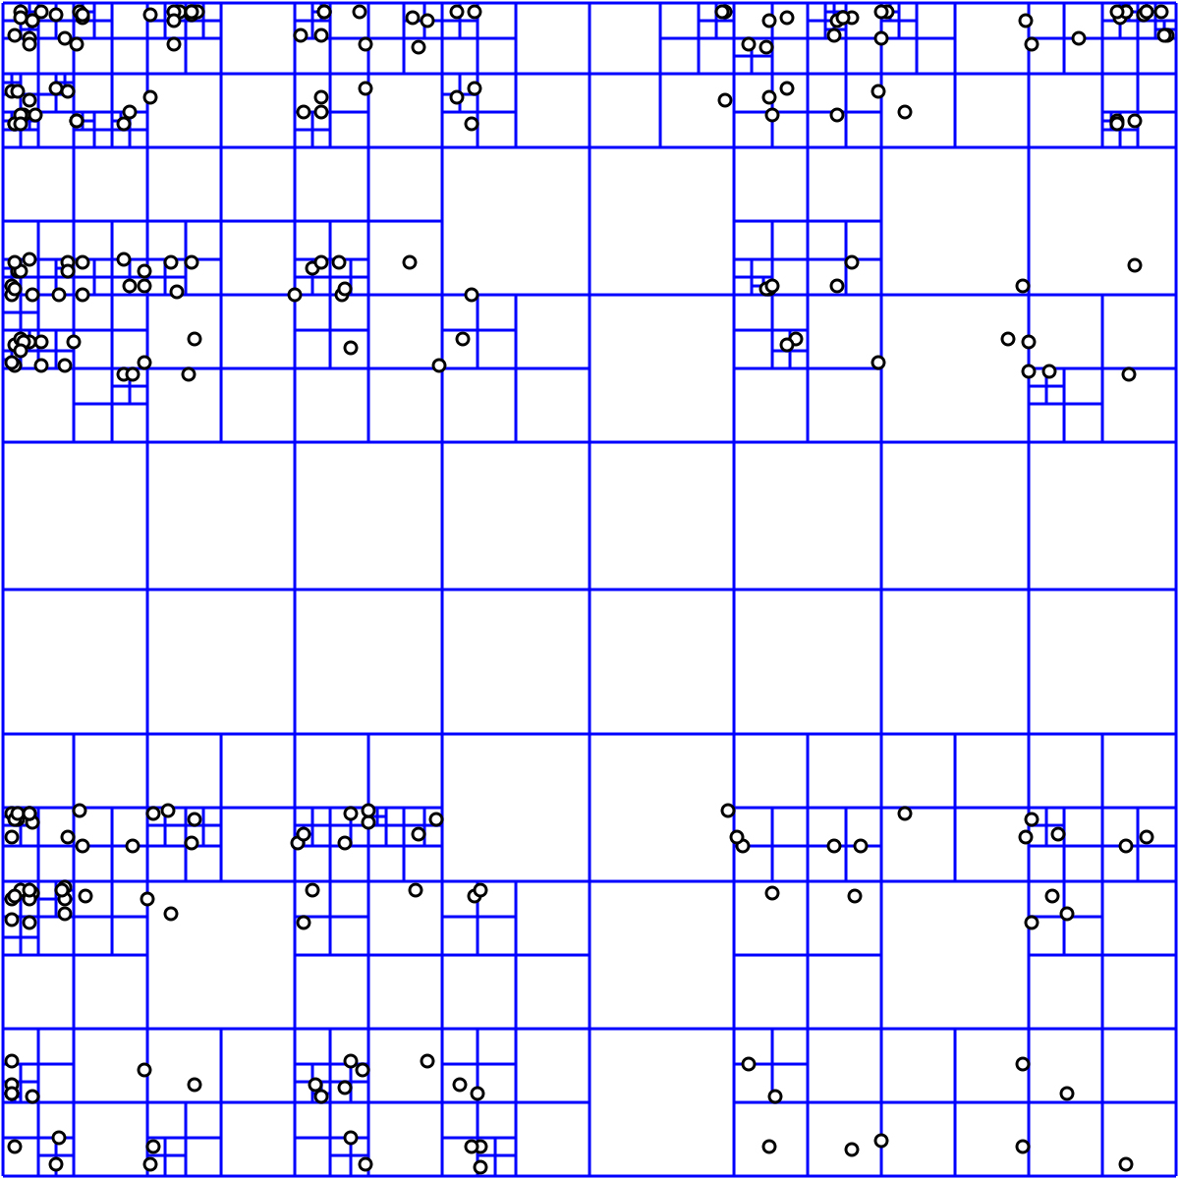
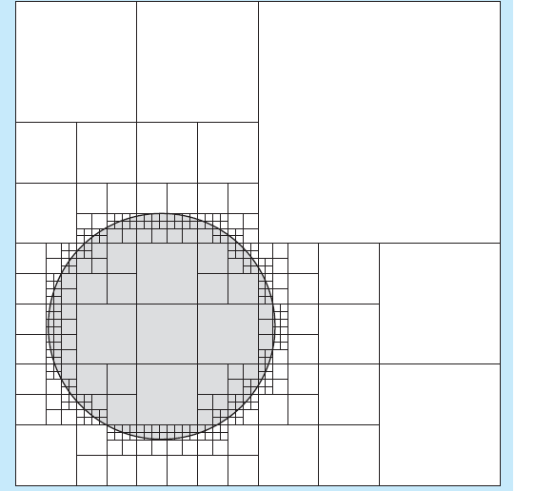
Quadtree
·Generally 2D
·When it reaches max node capacity -> split

Slide 9
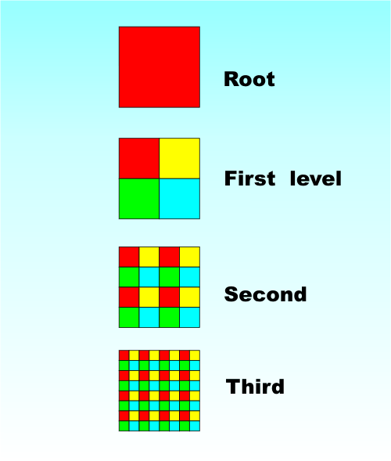
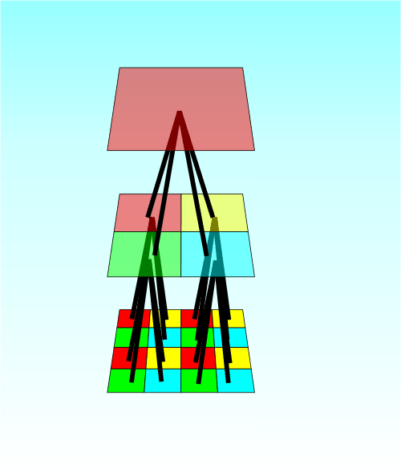
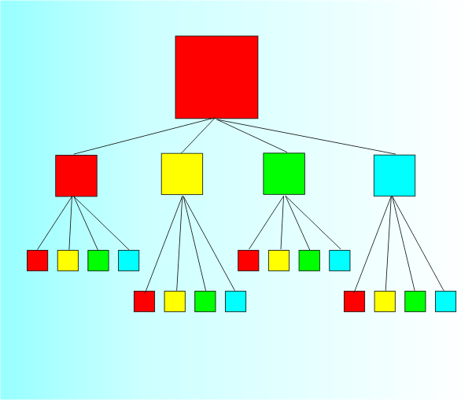
Quadtree, Tree

Slide 10
Quadtree, Tree

Slide 11
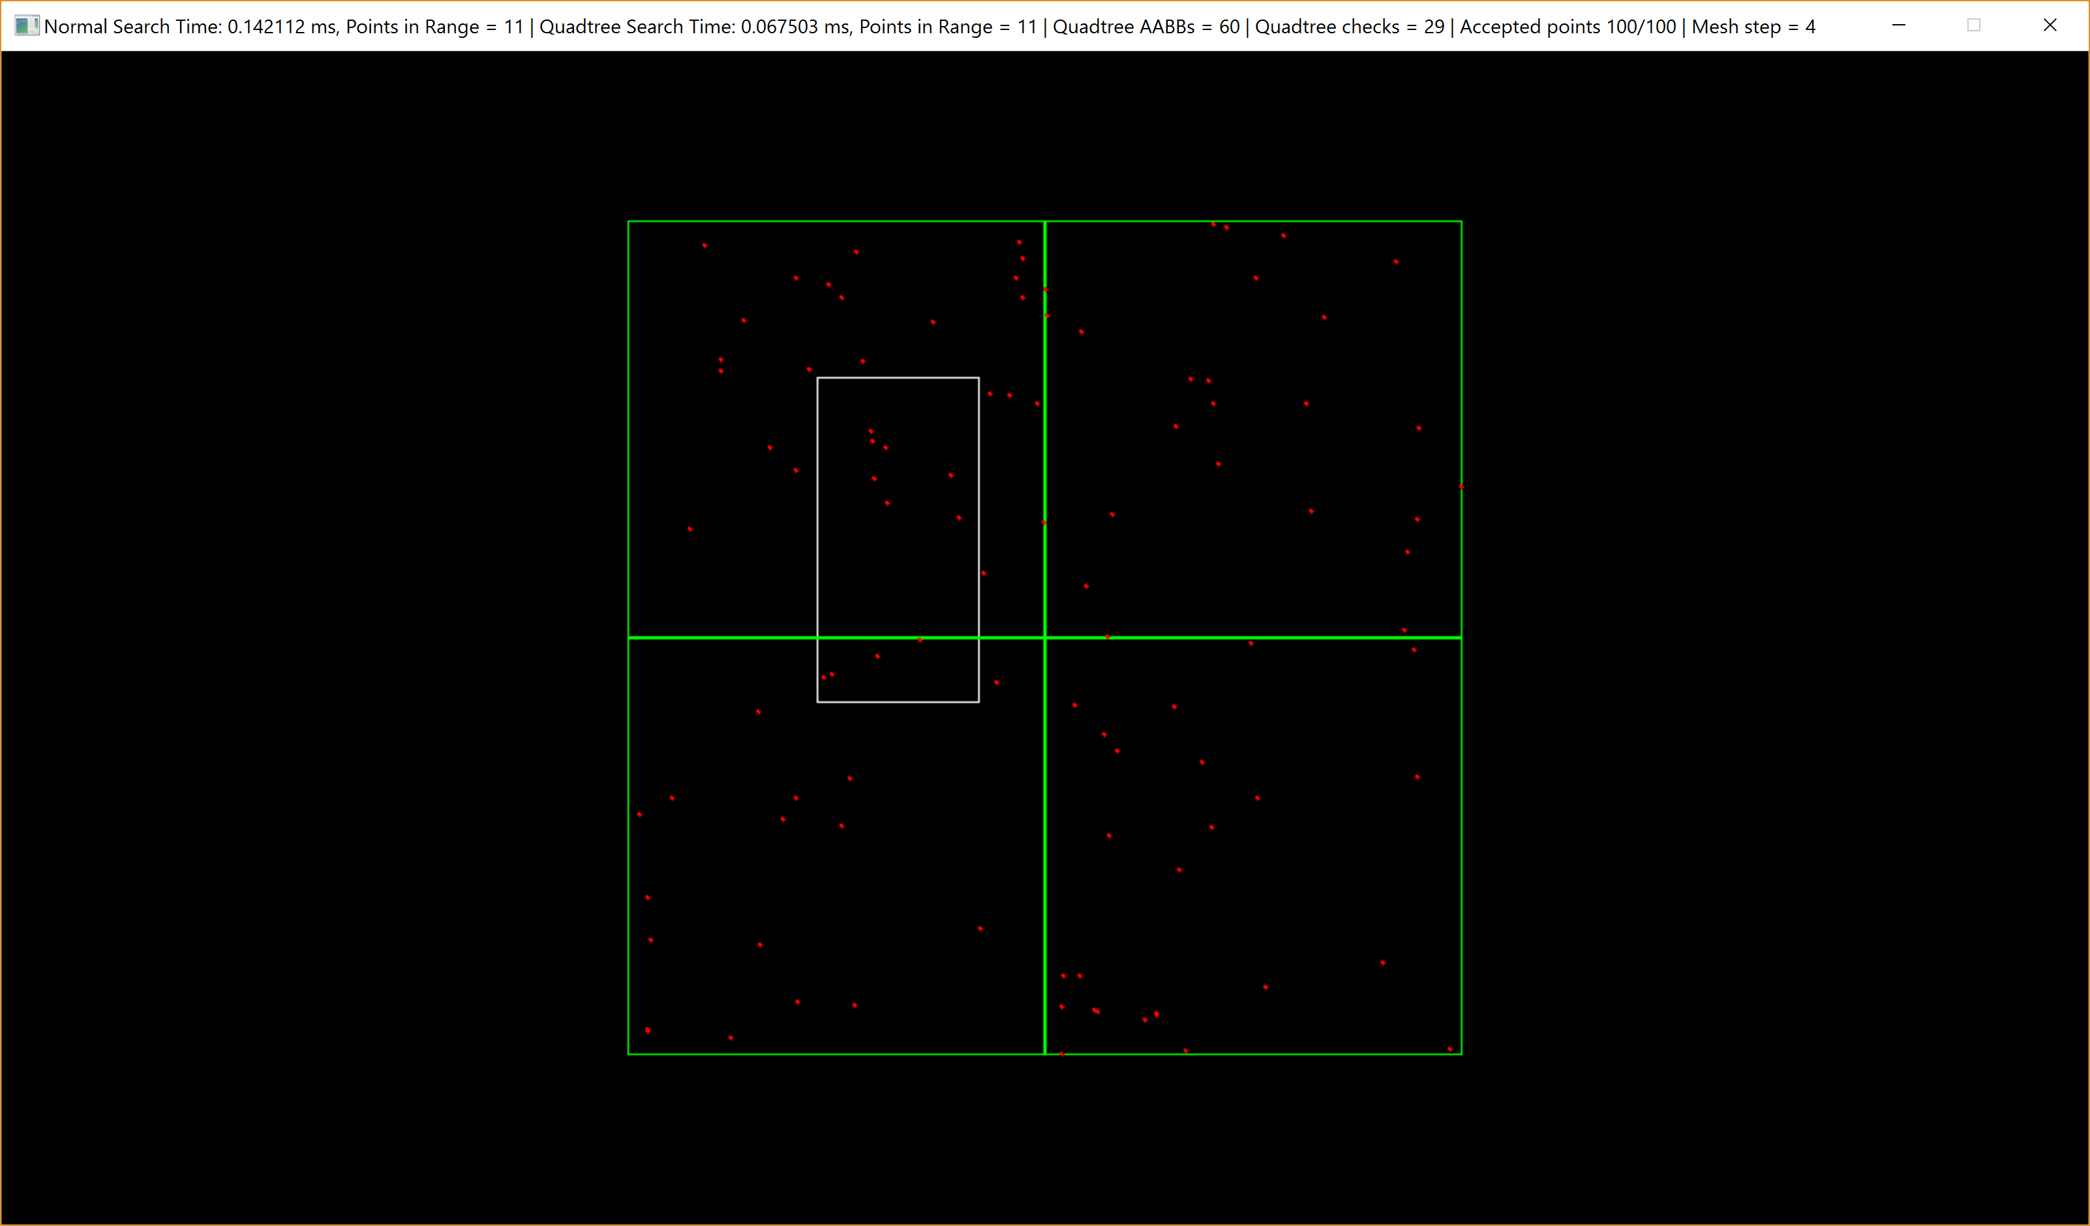
Quadtree, Tree

Slide 12
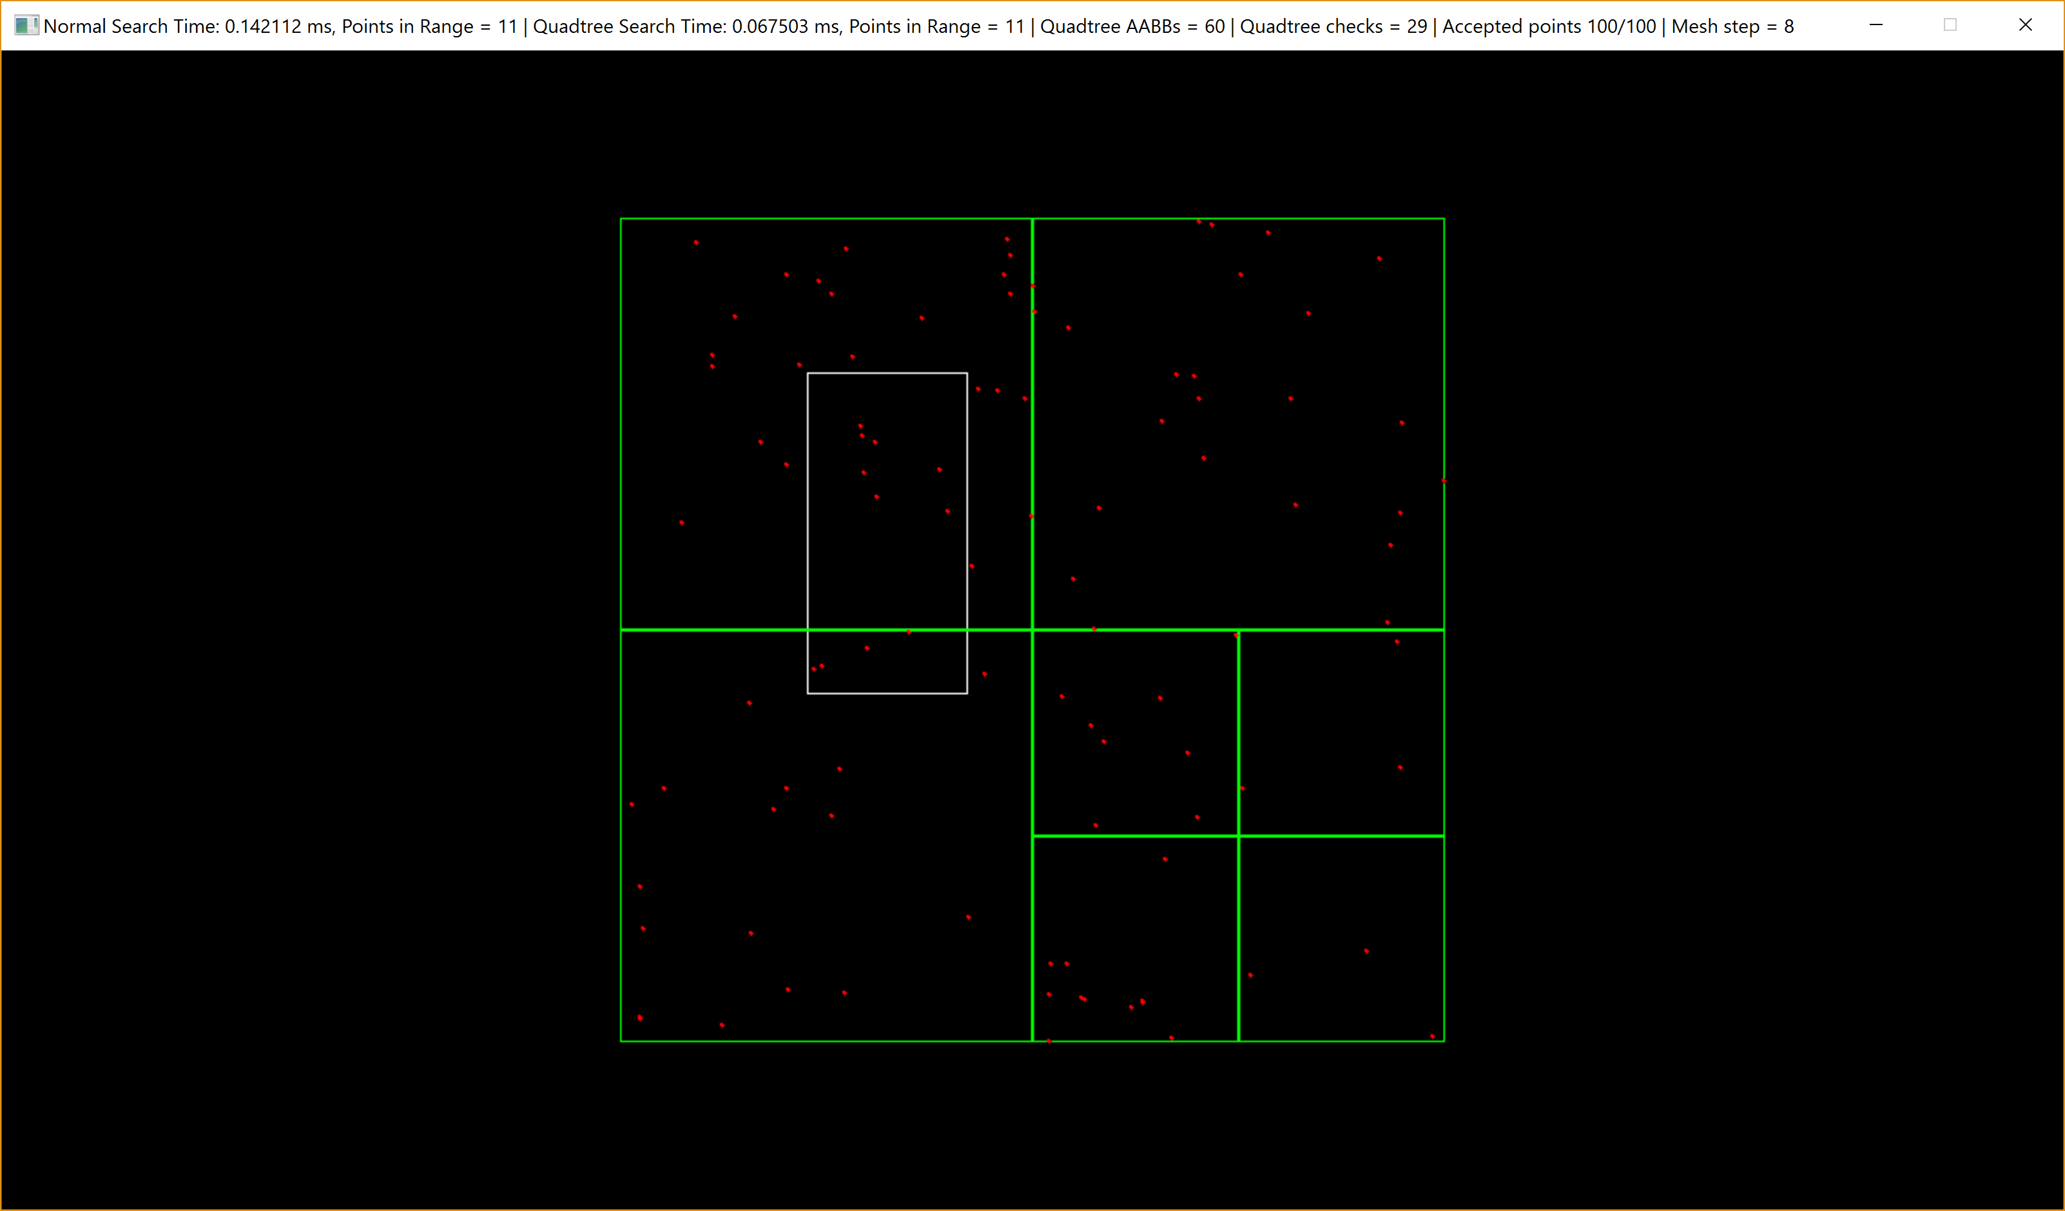
Quadtree, Tree

Slide 13
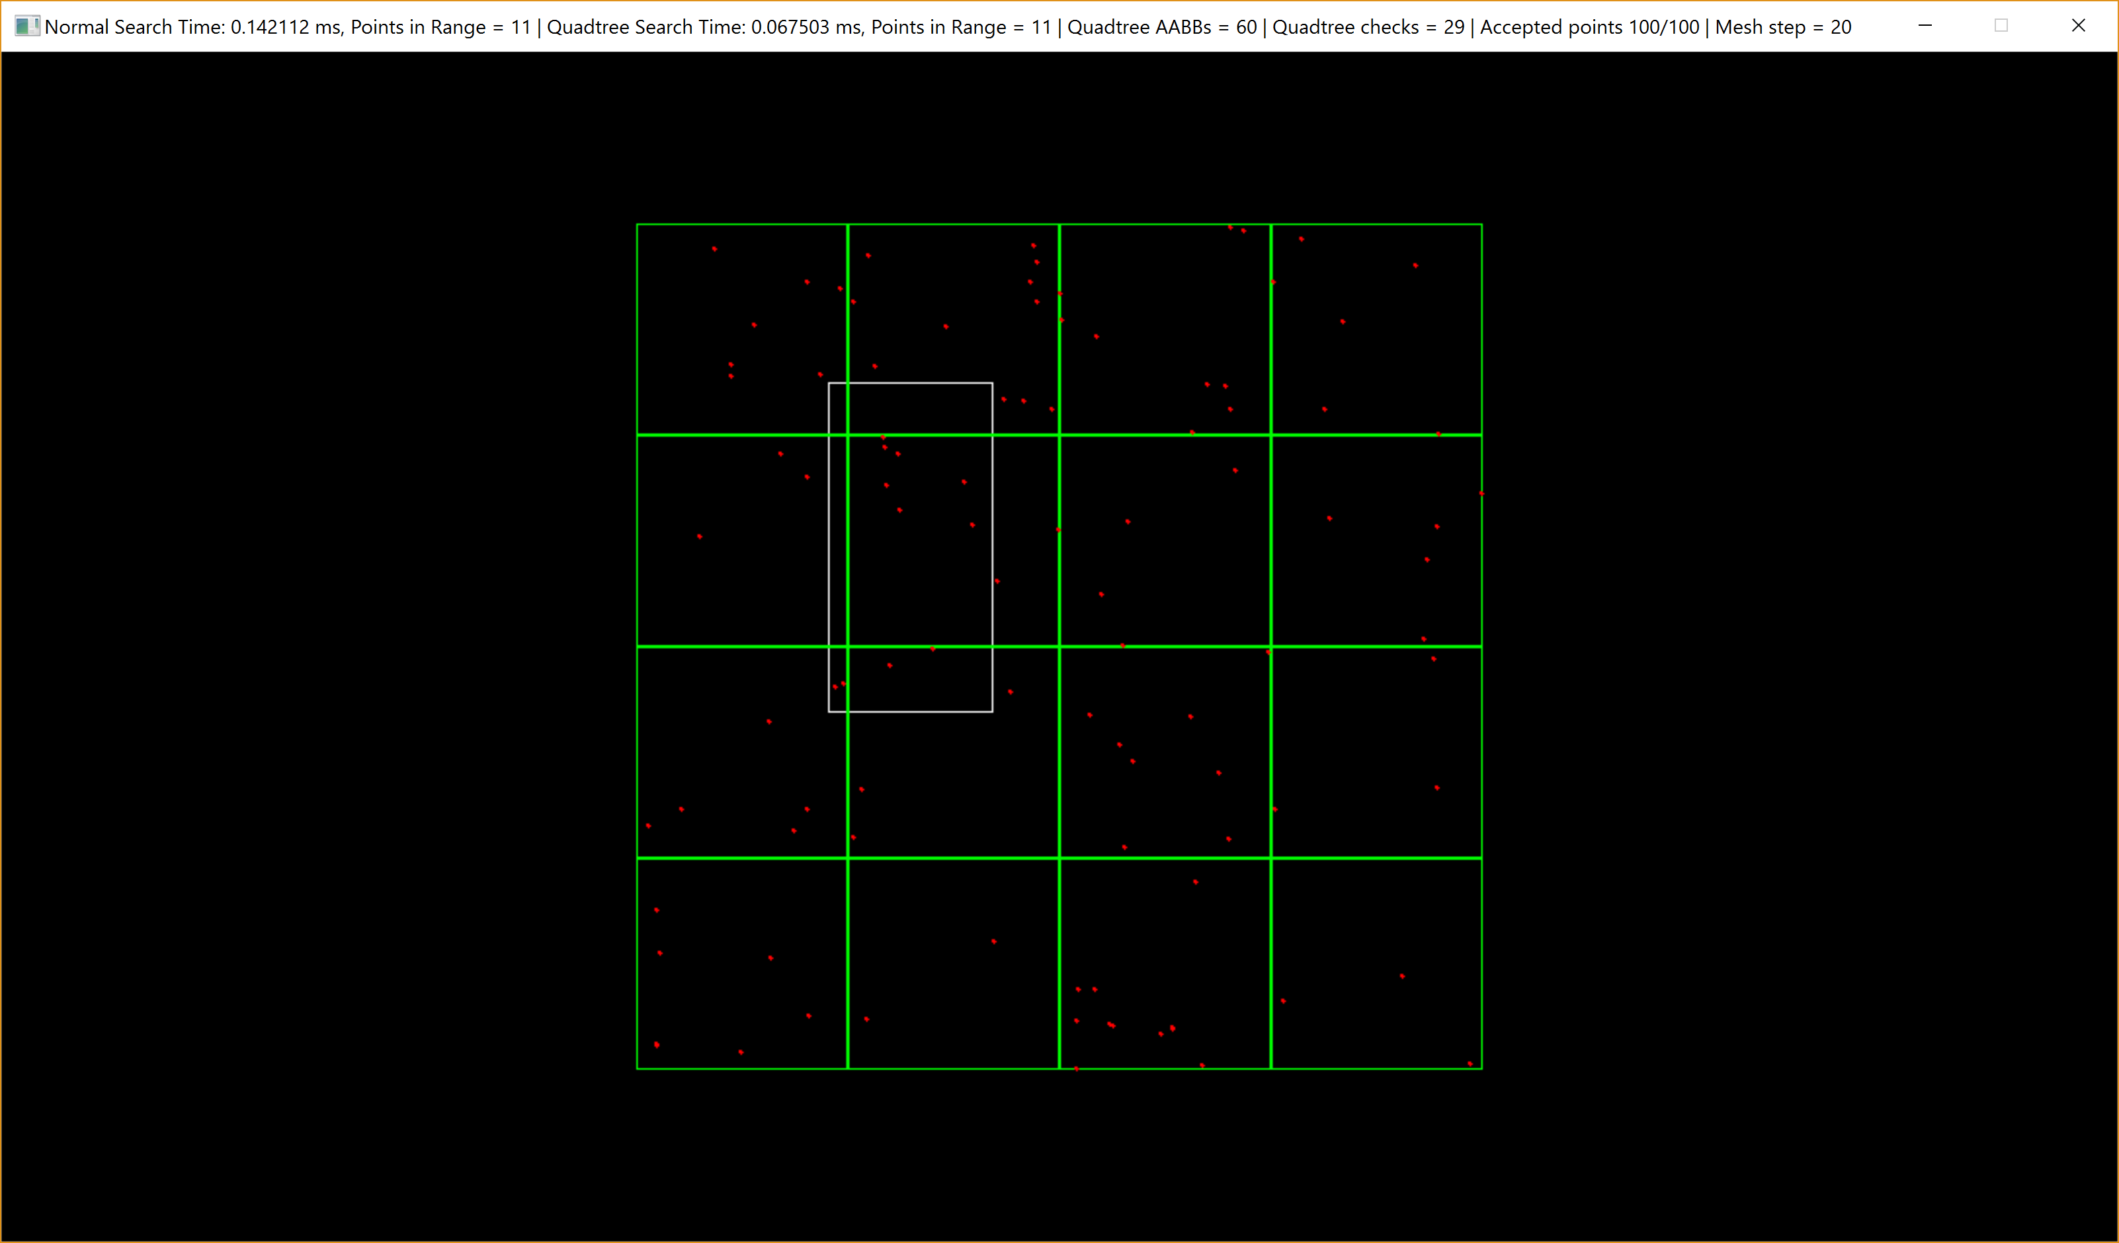
Quadtree, Tree

Slide 14
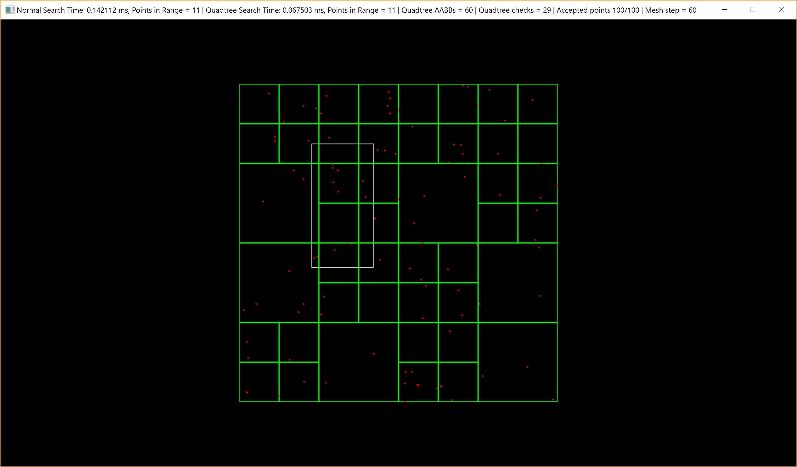
Quadtree, Tree

Slide 15

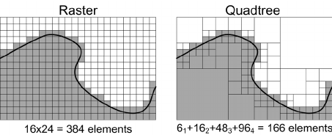
Quadtree, Where is used?
Image processing/compression

Slide 16
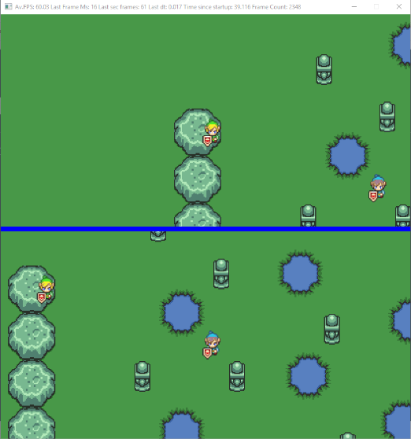
Quadtree, Where is used?
·Collisions
·Camera culling

Slide 17
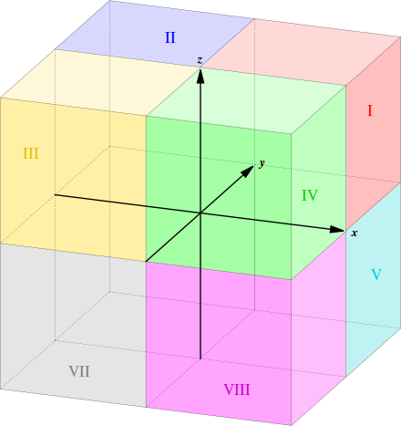
Octree
·Quadtree analogue in 3D
·3D graphics and video game engines

Slide 18
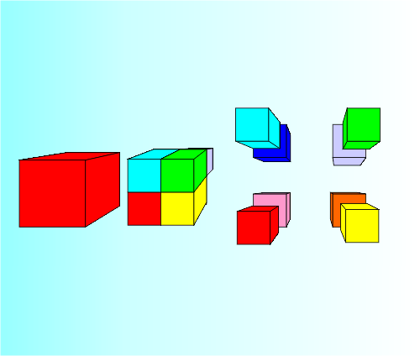
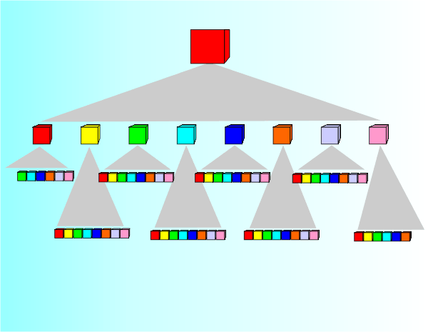
Octree, Tree

Slide 19
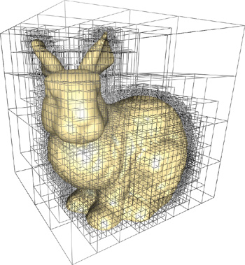
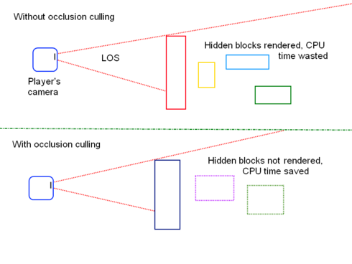
Octree, Where is used?
· 3D Graphics
· Efficient collision detection in three dimensions
· Occlusion Culling (OC)

Slide 20
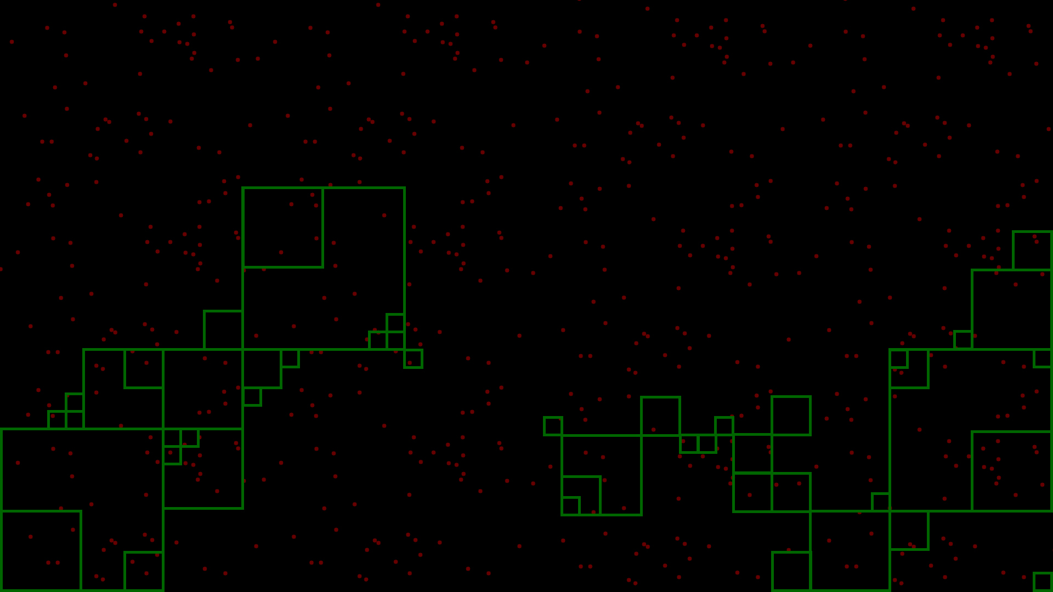
Why they are faster?

Slide 21
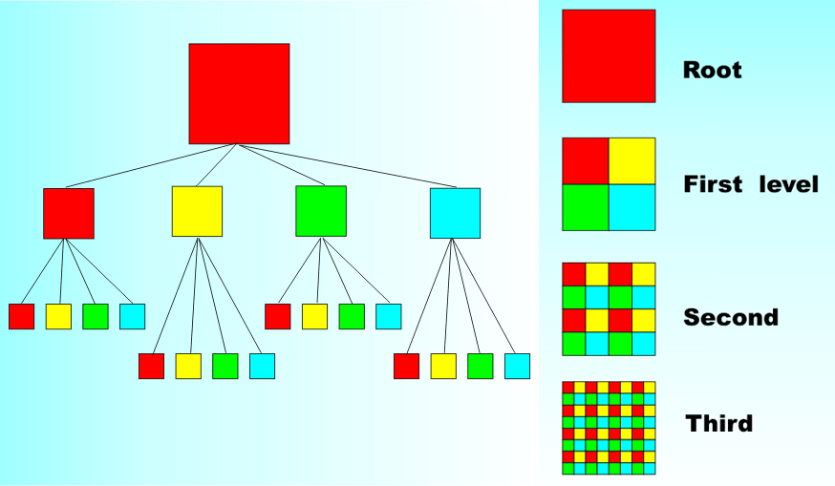

Slide 22
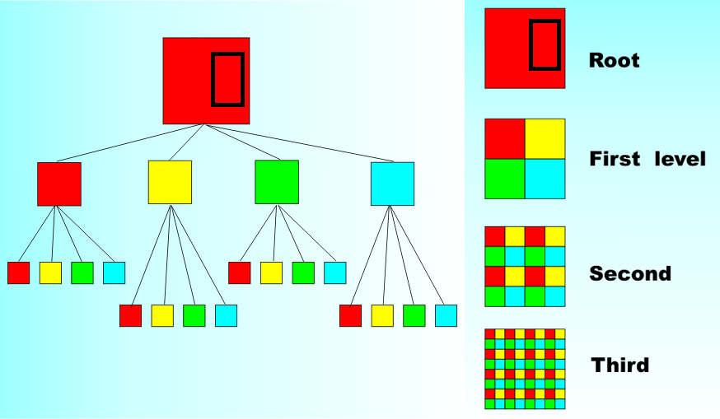

Slide 23
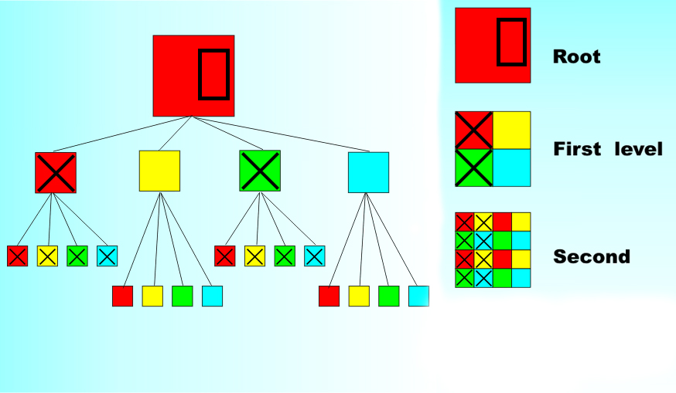

Slide 24


Slide 25
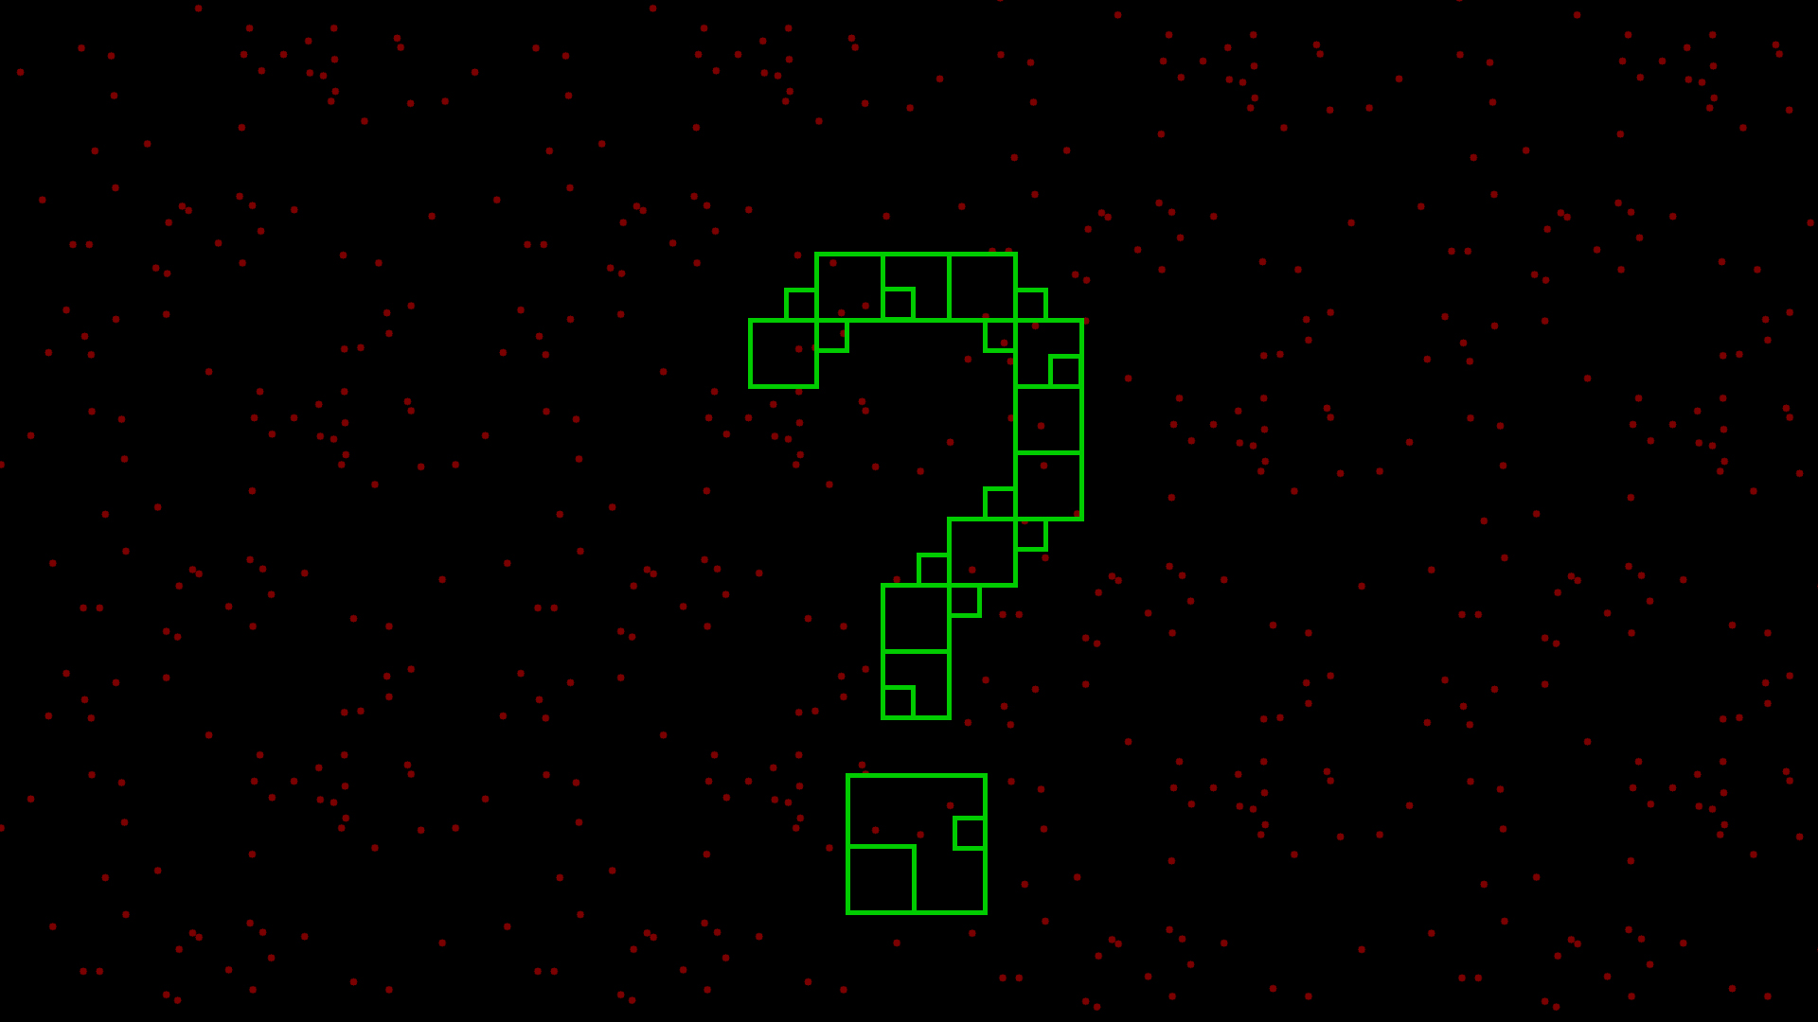
Any question?

Slide 26
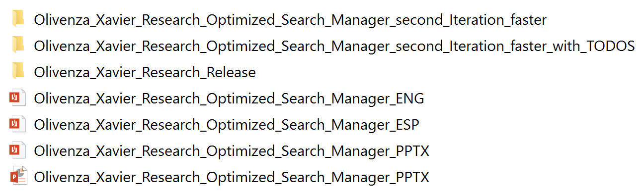
Before TODOs
R,S,F1,F2,Q,A

Slide 27
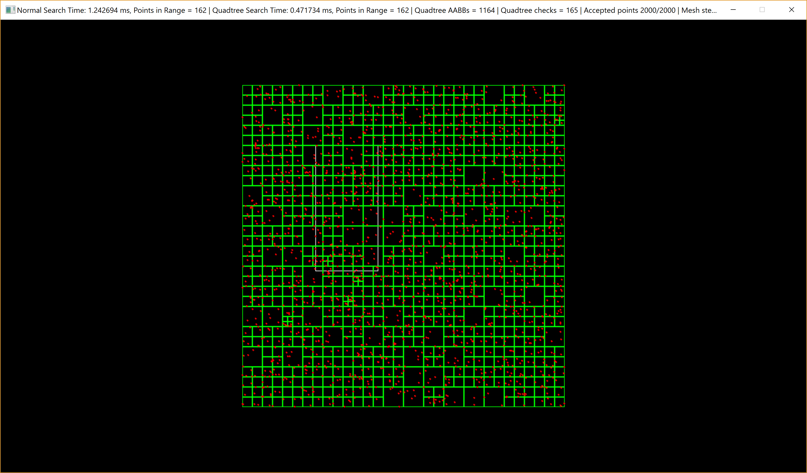
Before TODOs

Slide 28
TODOs with the Quadtree implementation
Now get the release of my repository and proceed to do the TODOs in SDLQuadtree.cpp

Slide 29
TODO 1
bool AABB::Insert(iPoint* newpoint)
{
// TODO 1: The new point is inside the quadtree AABB?
return false;
}

Slide 30
TODO 2
bool AABB::Insert(iPoint* newpoint)
{
// TODO 1: The new point is inside the quadtree AABB?
// TODO 2: Add the point to the node if there is space for it (remember Max_Elements_in_Same_Node)
return false;
}

Slide 31
TODO 3
void AABB::subdivide()
{
// TODO 3: Calculate the size and position of each of the 4 new nodes
}

Slide 32
TODO 4
void AABB::subdivide()
{
// TODO 3: Calculate the size and position of each of the 4 new nodes
// TODO 4: Now we have all the positions and size of each number we
// can create each child with its AABB
// Don't forget to set child root
}

Slide 33
TODO 5
bool AABB::Insert(iPoint* newpoint)
{
// TODO 1: The new point is inside the quadtree AABB?
// TODO 2: Add the point to the node if there is space for it (remember Max_Elements_in_Same_Node)
// TODO 5: If there is not space, add the point to a subdivision
return false;
}

Slide 34
TODO 6
int AABB::CollectCandidates(std::vector< iPoint* >& nodes, const SDL_Rect& r)
{
uint ret = 0;
// TODO 6: Check if range is in the quadtree AABB
return ret;
}

Slide 35
TODO 7
int AABB::CollectCandidates(std::vector< iPoint* >& nodes, const SDL_Rect& r)
{
uint ret = 0;
// TODO 6: Check if range is in the quadtree AABB
// TODO 7: See if the points of this node are in range, get them
//(remember Max_Elements_in_Same_Node and ret to count how many points we check)
return ret;
}

Slide 36
TODO 8
int AABB::CollectCandidates(std::vector< iPoint* >& nodes, const SDL_Rect& r)
{
uint ret = 0;
// TODO 6: Check if range is in the quadtree AABB
// TODO 7: See if the points of this node are in range, get them
//(remember Max_Elements_in_Same_Node and ret to count how many points we check)
// TODO 8: If the node don't hace children, we can end
return ret;
}

Slide 37
TODO 9
int AABB::CollectCandidates(std::vector< iPoint* >& nodes, const SDL_Rect& r)
{
uint ret = 0;
// TODO 6: Check if range is in the quadtree AABB
// TODO 7: See if the points of this node are in range, get them
//(remember Max_Elements_in_Same_Node and ret to count how many points we check)
// TODO 8: If the node don't hace children, we can end
// TODO 9: If the noide has children, get them points
return ret;
}

Slide 38
Optional Homework
·Moving entities?
Adapt the code for it.
Maybe you will need a Remove method...

Slide 39
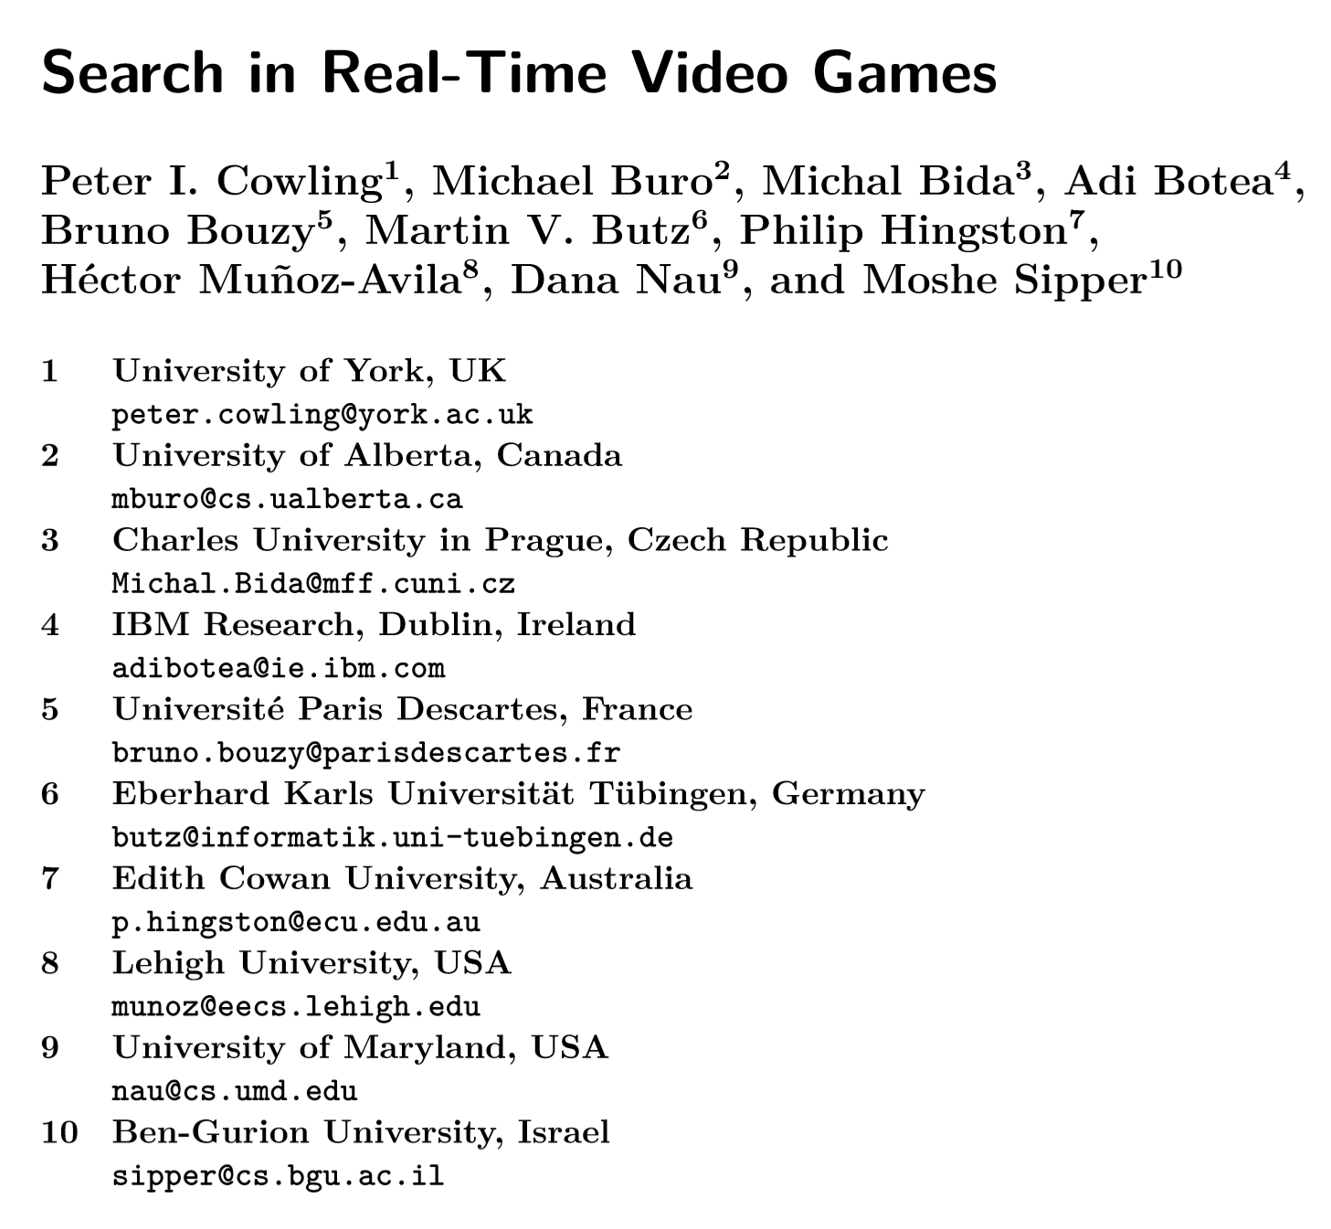
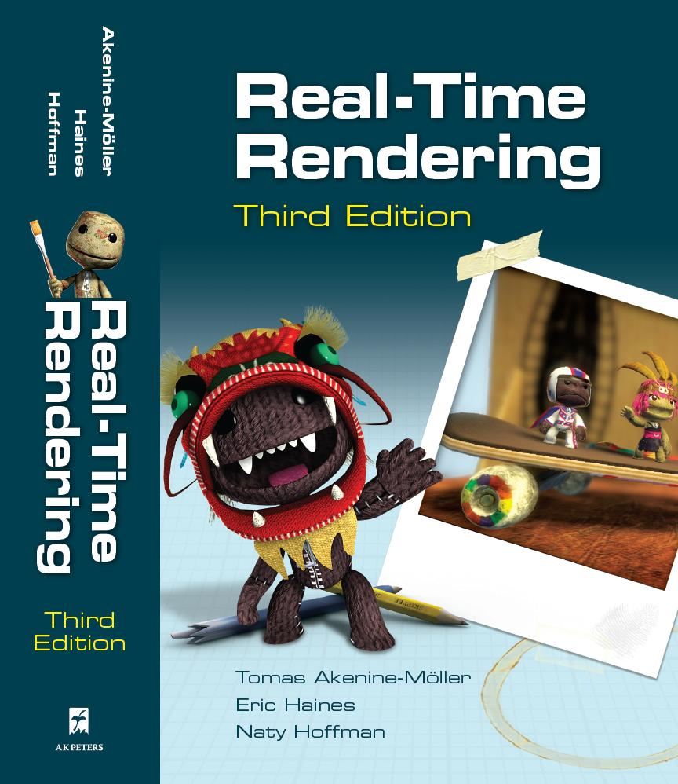
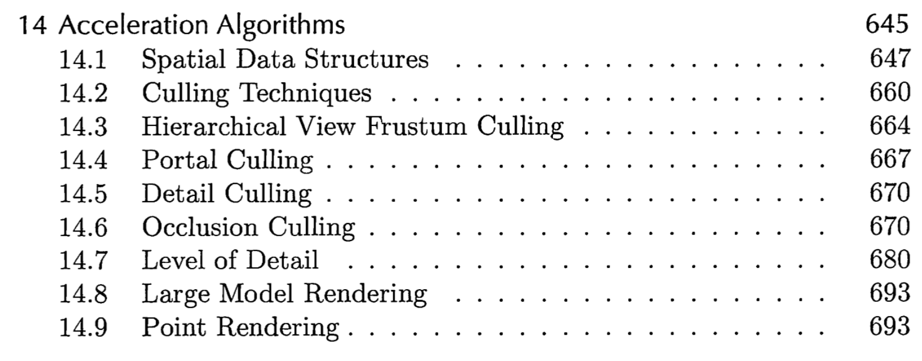
Optional Homework

Slide 40
Any last question?

